Slide 1
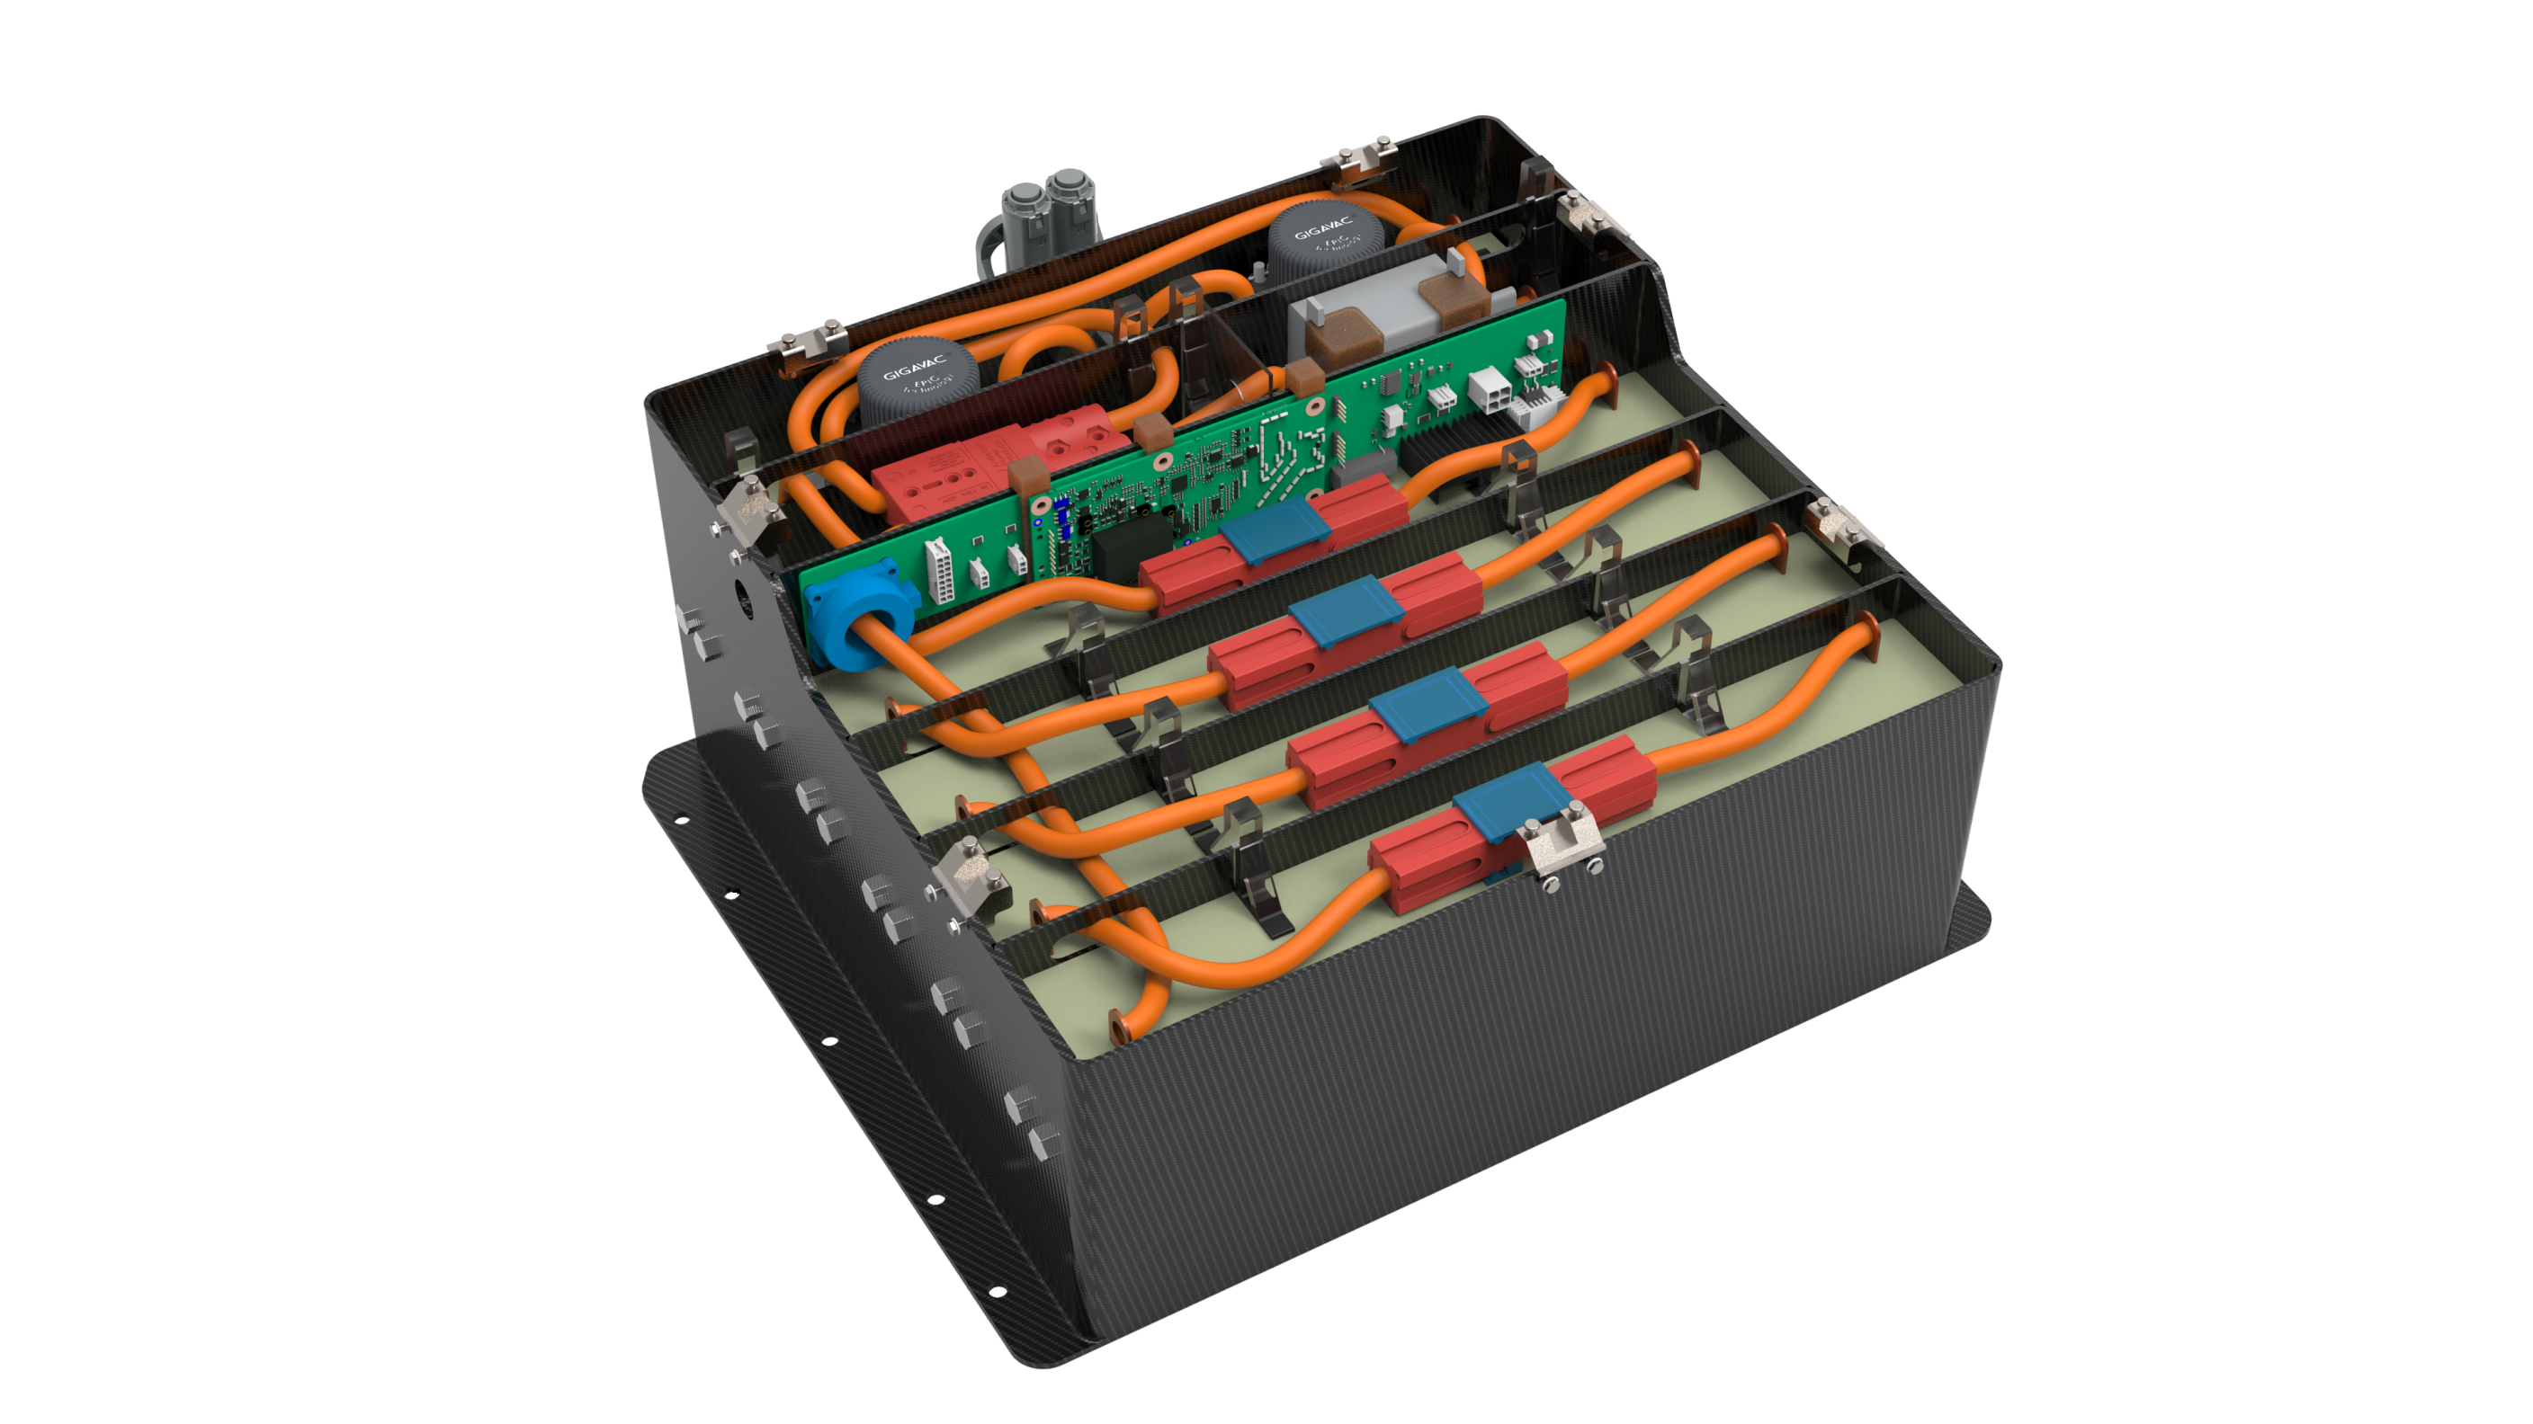
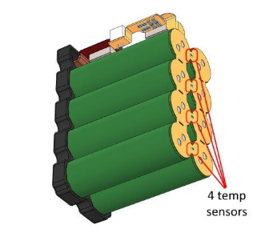
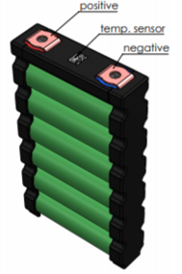
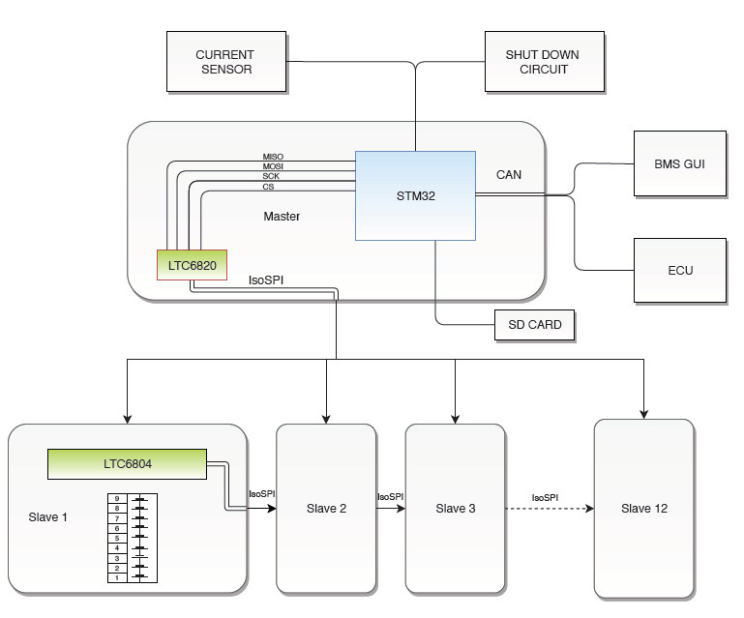
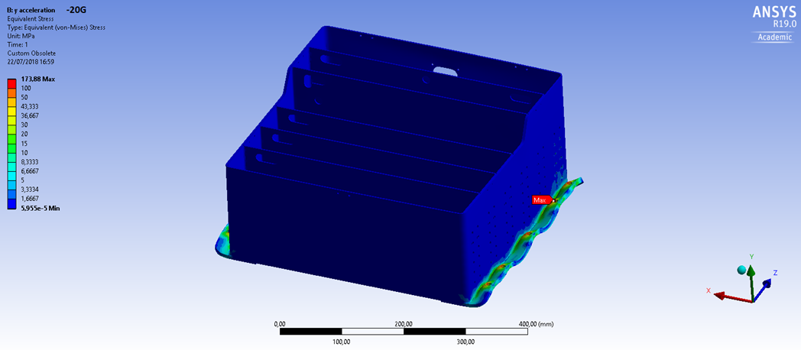
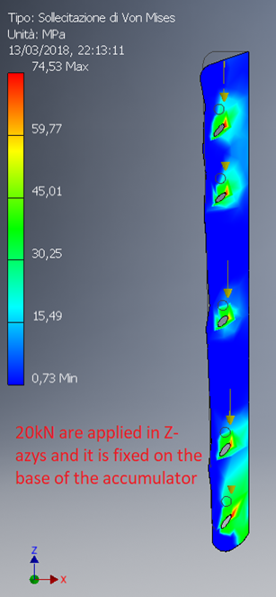


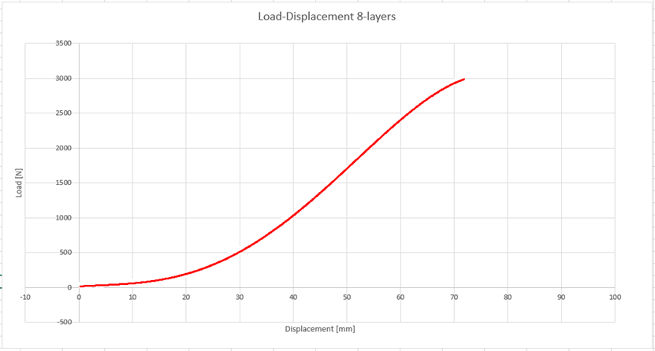


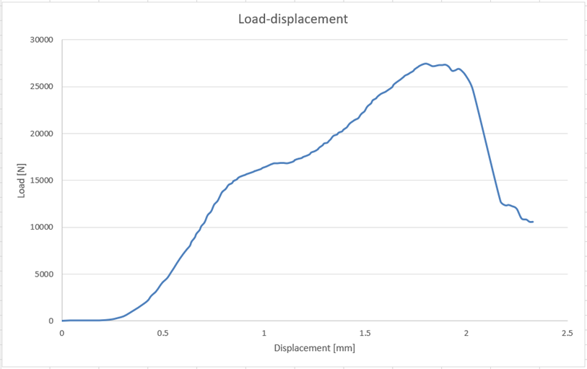
ACCUMULATOR IMPROVEMENT
KWH
CELLS SERIES
6 Sony VTC5 cells per module
15 Ah nominal cap
3,6 V nominal capacity
Built in temperature sensors for each cell
MAX V
WEIGHT
BATTERY MONITORING SYSTEM
Custom BMS suitable for our solution
Modular architechture for easy HW upgrade
Distribuited architecture
Internal isoSPI communication protocol
External CAN bus communication
MECHANICAL CONFIGURATION
Carbon Fiber case:
Weight reduced → -30kg
Low center of gravity
144 holes cool batteries
Simulation with:
Inventor 2018
Ansys 19.0
Carbon fiber tests with different disposition of layer:
3 points bending stress
Shear test
T800 twill, layer alternate 0°, 45°

